Slide 1
Postman: Environments

Slide 2
Contents
Purpose
Creating an environment
Using the environment data

Slide 3
Purpose
Environments helps you store variables which are environment agnostic.
With most APIs the routes will remain the same no matter where the service is running and only the base path will change.
For example:
https://fat8store.projectepic.net/api/rest/v1/catalog/products/28193005
https://syst.project4.com/api/rest/v1/catalog/products/28193005
Notes:
https://fat8store.projectepic.net/api/rest/v1/catalog/products/2%193005

Slide 4
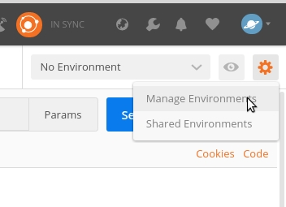
Creating an Environment
To create an Environment click the cog on the top right
Manage Environments
Click Add
In the header toolbar, click the New button.

Slide 5
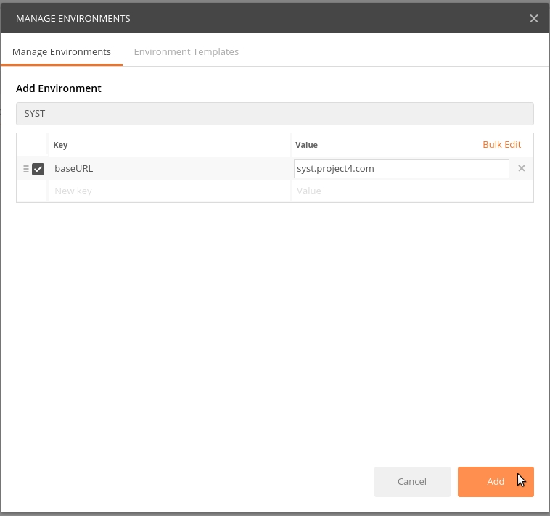
Click “Environment” and enter a name for the new environment
In the New key field type ‘baseURL’
In the Value key field type ‘syst.project4.com’
Click Add

Slide 6
You should now see the environment listed in the ‘Manage Environments’ section
Click the X to close the window
*There are other ways to do this but we’ll just cover the one way for now

Slide 7

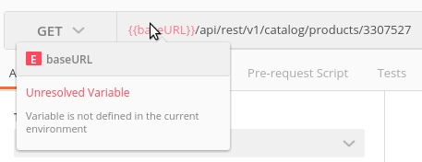
Using the environment data
We now need to reference this data in a request
To link to values Postman uses double curly brackets
So if we reference the key we have just created it looks like this: {{baseURL}}
And when we use it in a request it looks like this: {{baseURL}}/api/rest/v1/catalog/products/28193005
If you try the above {{baseURL}} will be in red
And if you hover over {{baseURL}}

